Slide 1

Optimizing Destination Recommendations with Machine Learning
A Study on Python-Driven Itinerary Planning Systems.

Slide 2

Presented by:
Nanda 20781A1220
Khursheed 20781A1233
Junaid 20781A1235
Safiya 20781A1244
Naren 20781A1244
Babu 20781A1253
Team mentor and Guide
Mr. P. Nandakumar, M.E,(Ph.D)

Slide 3
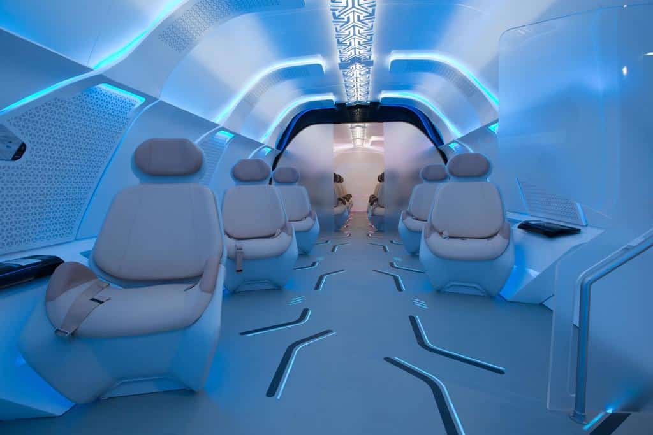
Abstract
This study introduces a novel itinerary planning system, designed to optimize destination recommendations using advanced machine learning algorithms. In the era of personalized travel experiences, the need for intelligent and adaptive planning tools is paramount. Our system, developed using Python, harnesses the power of machine learning to analyze traveler preferences and patterns, offering customized destination suggestions. The core of this study is to demonstrate how machine learning can transform traditional travel planning into a more efficient, personalized experience. By integrating user data and preferences, the system proposes itineraries that not only align with individual interests but also enhance the overall travel experience. This paper details the development process, the machine learning techniques employed, and the efficacy of Python in creating a dynamic and responsive travel planning tool.

Slide 4

Introduction
The activity of tourism has been the centre of attraction in many walks of life. The review of some information from several travel web services, notice that the all the countries of the world there are separate ministries of tourism.
Nearly 90% scenic spots are unseen which may be popular or unpopular, while the remaining spots attract most of the tourists.
A travelling from one to another location is essential for user and user can easily travel with the help of searching place and community collection of photos.
The matching kind of heterogeneous data associated with the photos. To single user Point of Interest sequence, famous spots are ranked according to user’s attraction. Many users preferred appropriate season and time may be useful to give personalized travel recommendation.

Slide 5
Introduction
Optimizing Destination Recommendations aims at examining the popularity prediction with respect to change in time based on the features .
This research is essential, because of which application get the accurate accuracy of attractions POIs popularity prediction and trip planning for visitors.
There are many problems occur in tourist attractions such as find the nearest places, about accommodation and so on.
In this paper compare the different types of layer for building a tourist application. In hierarchical Multi clue modelling use four layer topic layer, POI layer, feature layer and tag layer.
Still study on various categories of procedure in hierarchical multi clue feature modelling.

Slide 6

Literature Review
The POI popularity prediction is very essential for tourism purpose. Most of the method on GPS but their having some limitation.
S. Jiang et al. have proposed inspect in large dataset is used to reduce user’s choice. Combine user choice on social media into the POI popularity prediction organization using collaborative filtering.
However, there are some problem occur in unvisited place and share some information according to user’s friend, some time there is a no recommendation about some spots.
M. Mazloum et al. proposed to check brand related things when user express their opinions about brand by sharing multiple post .
In sequence to solve the some problem by using topic model method and increase enhancement as well as working of these model are showed in many works, TPM(Topical Package Model) is a model for POI recommendation by making use of visitor’s choice according to their interest .

Slide 7

Literature Review
F. Gelli et al. proposed an image in social network that is some image become popular and other are unpopular . Recently, struggle has been used up to make enquire about POI popularity prediction of text which in social media
According to picture popularity, the major part in general property of digital picture.
Pictorial features are not too much powerful than general image in social with reference to popularity prediction.
Previous works had been done with respect to popularity rating definition but all these things are common about pictorial and context feature and continuously determine POI popularity prediction score.
Khosla et al. look about bothgood as well as bad characteristics like the object prediction of the art CNN classifier .

Slide 8
8
Existing System
Generic Recommendations: Existing travel planning platforms often provide generic recommendations based on popular tourist destinations and predefined categories, lacking personalization and customization.
Limited Data Sources: Many current systems rely on a limited set of data sources, potentially leading to biased or incomplete recommendations and overlooking lesser-known attractions.
Static Recommendations: Some systems offer static recommendations that do not adapt to changing user preferences or real-time contextual factors, resulting in less relevant suggestions.
Complex Interfaces: User interfaces in existing systems may be complex and overwhelming, making it challenging for users to input their preferences and navigate through recommendations effectively.

Slide 9
Proposed system
The proposed system provides a secure web service as well as tourist application in which the field of POI recommendation, image recommendation, location base recommendation using KNN algorithm and MHH(Motion History Histogram) algorithm.
In proposed system we focus on user’s preferences and recognize the user’s point of interest.
A hierarchical POI modeling technique contain four are topic layer and POI layer are semantic representation for POI, while feature present multi-clue representation for some property and last layer is nothing but the context layer contain text information .
Along with the layer we proposed MHH algorithm to extract emotion from posted image, to improve preference finding schem.
To classify the POI base location into appropriate category using KNN algorithm .

Slide 10
Hardware Requirements
Server:
Networking:
Client Devices:
Standard desktop or laptop computer with at least a dual-core processor and 8GB RAM.
Storage: Minimum 500GB HDD or SSD for storing POI data and tourist information.
Operating System: Windows 10 or Ubuntu Linux for hosting the recommendation system.
Stable internet connection with a minimum speed of 10 Mbps for data retrieval and communication.
Wi-Fi router or Ethernet connection for connecting client devices to the server.
Personal computers, laptops, tablets, or smartphones with web browsing capabilities.
Compatible with popular web browsers such as Google Chrome, Mozilla Firefox, or Safari.

Slide 11
11
System Architecture
Client Interface: User-facing interface for accessing the recommendation system through web browsers or mobile applications.
Server: Backend server responsible for data processing, machine learning model execution, and recommendation generation.
Database: Storage for tourist information, user preferences, and historical data.
Machine Learning Engine: Module for training and deploying machine learning models for personalized recommendation generation.
APIs: Integration with external APIs for fetching real-time data, such as weather forecasts, event schedules, and traffic information.
Feedback Mechanism: Component for collecting user feedback and updating recommendation models iteratively.

Slide 12
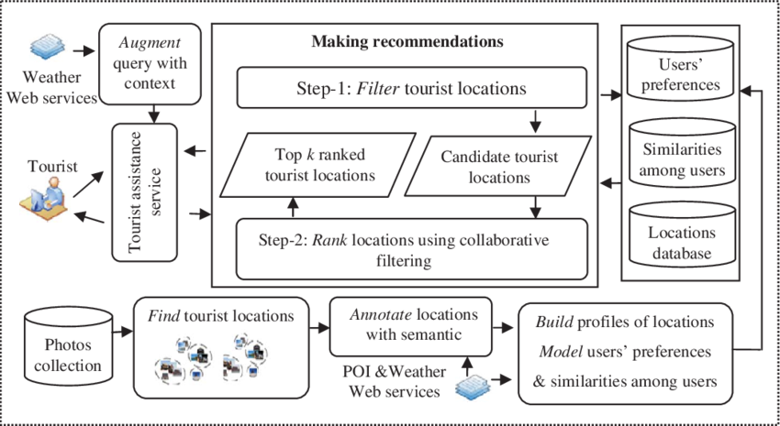
12
System Architecture

Slide 13
METHODOLOGY
13
The methodology for "Personalized POI Travel recommendation with multiple tourist information" involves several key steps to provide tailored travel suggestions to users based on their preferences and contextual information while leveraging multiple sources of tourist information. Here's an outline of the methodology:

Slide 14
System requirements
Operating System:
Windows or Linux
Software Dependencies:
Database Management System: Stream for storing and managing POI data.
Web Server: Apache or Nginx for hosting the recommendation system's web interface.
Programming Languages: Python for backend development, HTML/CSS/JavaScript for frontend.
Machine Learning Libraries: Scikit-learn for building simple recommendation models based on user preferences.

Slide 15
System Requirement
1. Scalability Considerations:
- The system should be designed to accommodate future growth and increased user demand.
- Scalability can be achieved by using cloud-based hosting services such as AWS or Google Cloud Platform, allowing for easy scaling of resources based on traffic patterns and user activity.
3. Data Backup and Recovery:
- Implement regular data backup procedures to ensure the integrity and availability of POI data and user preferences.
- Utilize automated backup solutions and off-site storage to protect against data loss due to hardware failures or unforeseen events.
3. User Interface:
Simple and intuitive web interface with basic navigation and interaction features.
Responsive design to ensure compatibility with different screen sizes and devices.

Slide 16
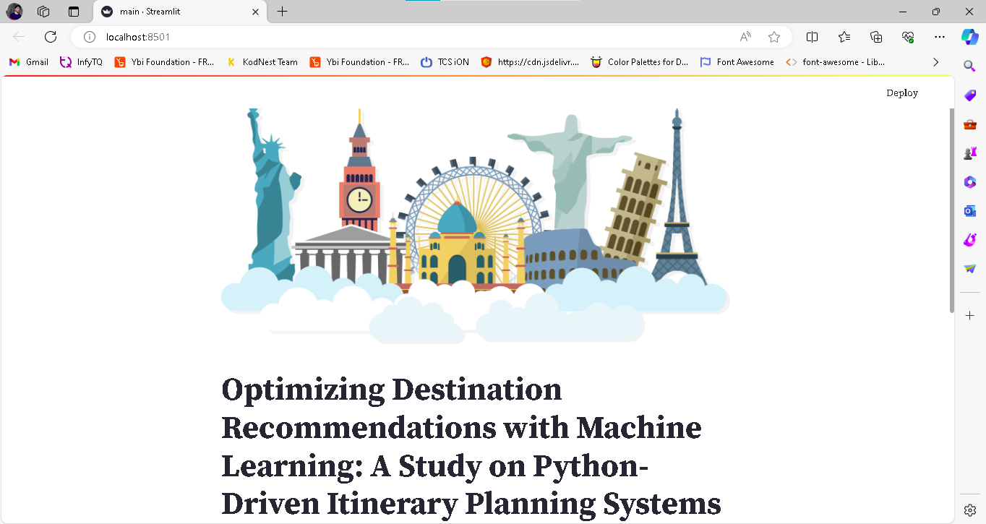
Interface

Slide 17
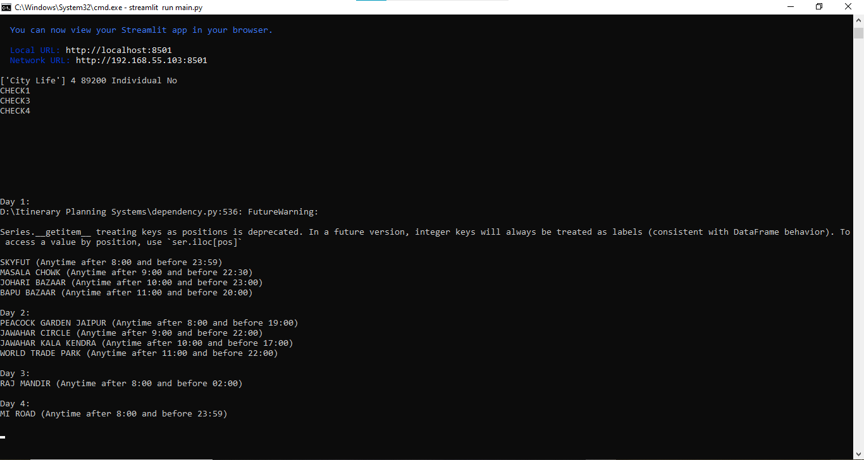
Expected Output

Slide 18
Scope of Project
18
Personalization: The project aims to provide highly personalized travel recommendations tailored to individual user preferences, including interests, budget constraints, travel dates, and preferred destinations.
Multiple Tourist Information Sources: The system will integrate data from various sources, including online travel guides, user reviews, social media platforms, and official tourism websites, to offer comprehensive and diverse recommendations.
Real-Time Contextual Analysis: Incorporating real-time contextual factors such as weather conditions, local events, and nearby attractions will enable the system to offer up-to-date and relevant recommendations.
Interactive User Interface: The project will develop an intuitive and user-friendly interface allowing users to input their preferences, explore recommendations, and customize their travel itineraries seamlessly.

Slide 19



Conclusion
Recommendation, Optimizing Destination Recommendations recommendation is presented in this paper.
This paper highlighted on user choices to find out the user’s POI.
Along with hierarchical multiclue model follow some layer and improve the preference finding schema.
Classification is made for data recommendation.
Observations were made to study the comparison in accordance with exactness and efficiency of the web services and applications.

Slide 20
References
20
[1] N. Yasavarapu, R. Pitchiah, "An Efficient Approch for Personalized Travel Sequence Recommendation On Multi source Big Social Media", pp. 2456-3307, Vol. 3, Issue 1, 2018.
[2] Y. Yang, Member, IEEE Y. Duan, X. Wang, Zi Huang, Ning Xie, H.T. Shen, "Hierarchical Multi-Clue Modelling for POI Popularity Prediction with Heterogeneous Tourist Information", IEEE Transaction on Knowledge and Data Engineering, ISSN. 1041-4347, Issuie no. 1, August 2018.
[3] Y. Duan, X. Wange, Y. Yang, Z. Huang, N. Xie and H. T.Shen, "POI popularity prediction via hierarchical fusion of multiple social clue", in SIGIR, 2017, pp. 1001-1004.
[17] H. Meng, B. Romera-Paredes, N. Bianchi-Berthouze, “Emotion Recognition by Two View SVM-2K Classifier on Dynamic Facial Expression Feature”, In NIPS, pp. 355-362, 2005.
[4] M. Sarma, Y. Srinivas, L. Ullala, M. Sahithi Prasanthi, J. Rojee Rao, “Insider Threat Detection with Face Recognition and KNN User Classifier”, in IEEE International Conference on Cloud Computing in Emerging Markets, pp. 39-44, Vol. 1, 2017

Slide 21




Thank you

